Slide 1
Chap 6: Structrues

Slide 2

Introduction
Program = Algorithm + Data structure
Subsequent, selection and loop blocks of statements.
Function: a group of statements achieves a specific task.
Nikiklaus Wirth
Notes:
凭借一句话获得1984图灵奖的Pascal之父——Nicklaus Wirth，让他获得图灵奖的这句话就是他提出的著名公式：“算法+数据结构=程序”。
这个公式对计算机科学的影响程度足以类似物理学中爱因斯坦的“E=MC^2”——一个公式展示出了程序的本质。

Slide 3
Introduction
Program = Data structure +Algorithm
Data structure
Data Types
Derived
Types
Fundamental
Types
User-defined
Types
Arrays
Pointers
Integral Types
Float / double
Character Types
Structures
Unions
Enumerations

Slide 4
Introduction
Data structures enable us to access and manipulate data in a relatively easy manner, and thus generate efficient programs.
An array is a fixed-size sequenced collection of elements of the same data type.
A pointer is nothing but a variable that holds (contains)
an address, which is a location of an object in memory.
A structure is a convenient tool for organizing a group of logically related data items with different types.

Slide 5
Introduction
Data structures enable us to access and manipulate data in a relatively easy manner, and thus generate efficient programs.
A structure: a convenient tool for organizing a group of logically related data items with different types.
time : seconds, minutes, hours
date : day, month, year
book : author, title, price, year
address : name, door-number, street
pointer : x, y coordinates
rectangle : coordinates of vertices

Slide 6
Structure declaration
Not like derived types, the formats or members of a structure have to be declared first and then structure variables can defined later.
General form for declaration
struct tag_name
{
data_type member1;
data_type member2;
… …
… …
};

Slide 7
Declaration example
struct book_bank{
char title[20];
char author[15];
int pages;
float price;
};
It declares a structure that contains the details of four data fields, namely title, author, page, price.
These fields are called structure elements or members.
Structure members may belong to a different type of data.
sizeof( struct book_bank)?
Not a variable with memory allocated

Slide 8
Variable definition
The tag name can be used to declare/define structure variables later.
General form
Examples:
struct book_bank book1, book2, book3;
Memory blocks are allocated to the variables according to the template declared before.
struct tag_name var_name1, var_name2;
sizeof( struct book_bank)==sizeof(book1)

Slide 9
Combing declaration and definition
struct {
char title[20];
char author[15];
int pages;
float price;
} book1, book2, book3;
struct book_bank{
char title[20];
char author[15];
int pages;
float price;
} book1, book2, book3;
Without a tag name, we cannot use it for future declarations.
Normally, structure declaration appear at the beginning of the program file, before any variables or functions are defined. Therefore, the declaration is global and can be used and altered by other functions as well.

Slide 10
Using typdef
Using typedef to declare a type name which can be used as any other fundamental and derived types.
Using the declared type name to define variables without the keyword struct
typedef struct{
type member1;
type member2;
…
} type_name;
type_name variable1, variable2,…, variablen;

Slide 11
Structure initialization
Initialize structure variables on definition
struct student
{
int iNum;
char cArrName[20];
char cSex;
float fScore;
} strStu0;
struct student strStu1={102,"Zhang Ping",'M',78.5};

Slide 12
Copy and compare structures
Two variables of the same structure type can be copied the same way as ordinary variables.
The values in the memory of strStu1 are copied bytes by bytes to those of strStu2;
Arithmetic and logical operators are not permitted.
struct student strStu2, strStu1={102,"Zhang ping",'M',78.5};
strStu2 = strStu1;
strStu2+strStu1;
strStu2<strStu1;
strStu1 == strStu2;
scanf(" ? ",&strStu);

Slide 13
Pointer to a structure
We may declare a pointer to a structure variable.
We may obtain the address of the first byte of a structure variable and assign the address to a pointer.
The pointer works the same as any other pointers that point to variables of fundamental and derived types.
struct student *ptrStu2 = NULL;
struct student *ptrStu2 = &strStu1;
*ptrStu2 // Indirectly access the structure variable
ptrStu2 == ptrStu1; //ptrStu1 = &strStu1;

Slide 14
Access structure members
Using ‘.’ operator to structure variables
strStu1.iNum (*ptrStu1).iNum
strStu1.cArrName (*ptrStu1).cArrName
strStu1. cSex; (*ptrStu1). cSex;
strStu1. flScore (*ptrStu1). flScore
Using ‘->’ operators to a pointer to a structure variable
ptrStu1->iNum
ptrStu1->cArrName
ptrStu1->cSex;
ptrStu1-> flScore
These members can be used in any context where variables apply.
strStu1.iNumr ++;
++strStu1.iNum;

Slide 15
Array of structures
We may declare an array of structures, and each element of the array representing a structure variable.
We can access any structure elements by means of those accessing any elements with other types.
struct student int1_students[30];
int1_students[1]; // Access the first student variable
*(int1_students+1);
int1_students[0] = int1_students[1];
int1_students[0].iNum;
int1_students[0] == int1_students[1];

Slide 16
Exercise 1
Design a program to count candidates’ votes
There are N candidates who campaign the chairman.
M individuals participate in voting by entering the names of the candidates.
Input: the name of candidate
Output : The order of votes and the election results.
Name | Introduction | Poll
Obama | 。。。 | 3
Bush | 。。。 | 2
Clinton | 。。。 | 5

Slide 17
Functions and structures
Pass structure variables as arguments
Pass a copy of the entire structure to the called function.
Any changes to structure members within the function are not reflected in the calling function.
It is therefore, sometimes necessary for the function to return the entire structure back to the calling function.
Pass the pointers to structures as arguments.
The function can access indirectly the entire structure and work on it.
This is similar to the way that array names are passed to function.
This method is more efficient as compared to the first one because no vale copies of structure elements occur.

Slide 18
Example
struct Store{
char name[10];
float price;
int quantity;
};
void print( struct Store* pSto);
float mul(struct Store stock);
/* update the price and quantity of a product */
void update(struct Store product, float p, int q);

Slide 19
Example_contd
float mul(struct store Stock)
{ return(stock.price * stock quantity); }
void print(struct Store* p)
{ printf(“%s %f %d”, p->name, p->price,p->quantity); }
void store update(struct Store product, float p, int q)
{
product.price += p;
prodect.quantity += q;
}

Slide 20
Example_contd
int main(){
float p_increment, value;
int q_increment;
struct stores item={“XYZ”, 25.75, 12};
scanf(“%f %d”, &p_increment, &q_increment);
update(item, p_increment, q_increment);
value = mul(item);
print( &item);
return 0;
}

Slide 21
Example
struct Store{
char name[10];
float price;
int quantity;
};
void print( struct Store* pSto);
float mul(struct Store stock);
/* update the price and quantity of a product */
struct Store update(struct Store product, float p, int q);

Slide 22
Example_contd
float mul(struct store Stock)
{ return(stock.price * stock quantity); }
void print(struct Store* p)
{ printf(“%s %f %d”, p->name, p->price,p->quantity); }
struct store update(struct Store product, float p, int q)
{ product.price += p;
prodect.quantity += q;
return(prodcut);
}

Slide 23
Example_contd
int main(){
float p_increment, value;
int q_increment;
struct stores item={“XYZ”, 25.75, 12};
scanf(“%f %d”, &p_increment, &q_increment);
item = update(item, p_increment, q_increment);
value = mul(item);
print( &item);
return 0;
}

Slide 24
Exercise 2
struct Date{ int year, month, day; };
struct Person{
char name[20];
struct Date birthday;
}worker, *p = & worker;
A ．p->birthday->year=1978 ;
B． p ->birthday. year = 2000;
C． Person.birthday.year=1958 ;
D．worker .birthday={1978, 2, 14};

Slide 25

How to use structure
Nested structure
Structural members can not be their own structural variables
struct Person
{
long number;
char name[10];
char sex;
Person mother;
Person parents[2];
Person friends[3];
};

Slide 26
How to use structure
Nested structure
A pointer to its own structure can be used as a member.
struct Person
{
long number;
char name[10];
char sex;
Person* family;
Person* relative;
Person* friends;
};
Alice
Bob
Can

Slide 27


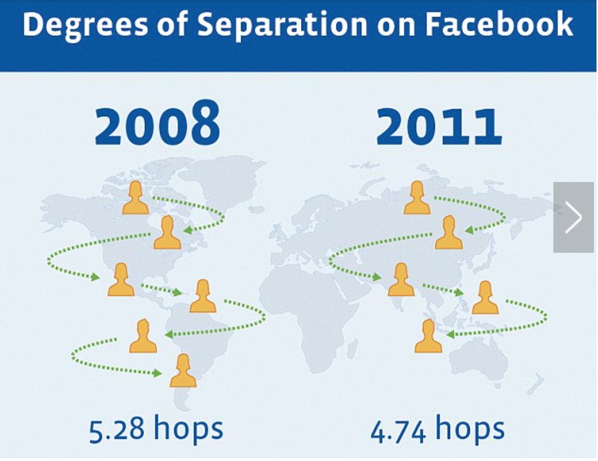

Small World Networks
Notes:
小世界网络中的六度分割理论

Slide 28
Management Information Systems（MIS）
struct Book {
char title[20];
char ISBN[20];
char* author;
int pages;
float price;
};
struct Book_recored{
char ID[20];
struct Book book;
int state;
struct Date d;
struct Reader person;
// borrowing record？
};

Slide 29

List-A self-referential structure
Linked list
A linear collection of data elements, called nodes, each pointing to the next node by means of a pointer.
Consists of a group of nodes which together represent a sequence.
Declaration
struct ListNode {
data; // The data being stored in the node
ListNode *pNext // pointer to the next , NULL for last node }；
Initialization
Starting from a NULL list
struct ListNode *pHead = NULL;
Construct the first node (head)
struct ListNode *pHead = (struct ListNode*) malloc(sizeof(struct ListNode)); pHead->data = …; pHead->pNext =NULL;

Slide 30
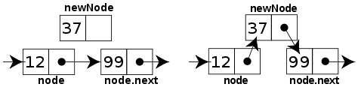
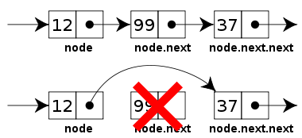
Linked list operations
Transverse
struct ListNode *cur = head;
while (cur !=NULL) { cur->data…; cur = cur->pNext}
Insert a node
Remove a node
Clear a list
InsertAfter(strcut ListNode *node,
strcut ListNode * newNode)
// insert newNode after node
{ newNode->pNext = node->pNext;
node->pNext = newNode;}
RemoveAfter(strcut ListNode *node)
// remove node past this one
{ struct ListNode *oldnode = node->pNext;
node->pNext = node->pNext->pNext;
//Destroy or free oldnode}

Slide 31

Insert sorting algorithm-array
Algorithm
Removes one element from the input data.
Finds the location it belongs within the sorted list
Inserts it there
repeats until no input elements remain.
Use an array to implement

Slide 32
In-place insertion
Insert an element to an ordered array to such a position that the expanded array is also an ordered one.
int iA[10]
1 | 3 | 5 | 8 | 9
int iValue
7
1 | 3 | 5 | 7 | 8 | 9

Slide 33
Algorithm
Find the position
Shift the elements afterwards
Assign the value to the position
int iValue
7
1 | 3 | 5
int iA[10]
8
9
7

Slide 34
Program
void insert_sort(int iA[], int iNumber, int iValue)
/* iA: target array; iNumber: current number in the array; iValue: value to be inserted*/
{
int i1, iIndex;
/*Find the position*/
for(i1=0;i1<iNumber && iA[i1] < iValue; i1++); /* Can use break */
/*Move elements */
iIndex=i1;
if (i1 < iNumber)
{
for(i1=iNumber-1; i1>=iIndex; i1--)
iA[i1+1]=iA[i1];
}
/*Insertion*/
iA[iIndex]=iValue;
}

Slide 35
Insertion Sorting
void insertion_sort_array(int a[], int n)
{
int i,j,k;
for (i=1; i < n; i++)
{
j = i-1;
k = a[i];
while (j>=0 && a[j]>k)
{
a[j+1]=a[j]; j--;
}
a[j+1]=k;
}
}

Slide 36
Insert sorting algorithm-array
Algorithm
Removes one element from the input data.
Finds the location it belongs within the sorted list
Inserts it there
repeats until no input elements remain.
Use an array to implement
Use a linked list to implement

Slide 37
Example of word count – Data structure
Write a program to count the occurrences of each (keyword) word in an input.
We need two arrays, one to hold the names and the other counts
char *keyword[NKEYS]; int keycount[NKEYS];
Store as a whole
struct key {
char *words;
int count};
//declaration
struct key keytab[] = {“auto”, 0,
“break”, 0,
“case”, 0, …,
“while”, 0};
//initialization
Why do we initialize the keys in alphabetic order?

Slide 38
Example of word count – Algorithm
Pseudo-code
//getword reads a word from an input
while ( getword(word, MAXWORD) != EOF)
if ( the first element of word is a letter)
if ( Find word in keytab as the nth)
keytab[n].count++;
print all
int binsearch(word, keytab, NKEYS);
//Refer to codes in pp.134 and 137;

Slide 39
Example of word count – Code review
What if the list of words is not known in advance?
Count the occurrences of all the words in an input
One solution is to keep the set of words seen so far sorted at all times.
Maintain the set in a tree such that at any node the left subtree contains only words that are less than the word at the node, and the right contains only those that are greater.
Now is the time for men of China
now
is
the
for
men
of
time
China

Slide 40
Example of word count – Algorithm
Pseudo-code
//getword reads a word from an input
while ( getword(word, MAXWORD) != EOF)
if ( the first element of word is a letter)
Addtree(root, word);
PrintTree(root);

Slide 41
Self-referential structure
Declaration
struct tnode{
char *word
int count;
struct tnode * left; // struct tnode left; ?
struct tnode *right;
};
Code for Addtree
Addtree(struct node *p, char *w)
{
if (p == NULL) // add a new node
else if ( (cond = strcmp(w, p->word)) == 0) p->count++;
else if (cond < 0) Addtree(p->left, w);
else Addtree(p->right, w);
return p;
}

Slide 42

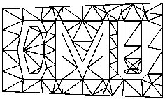
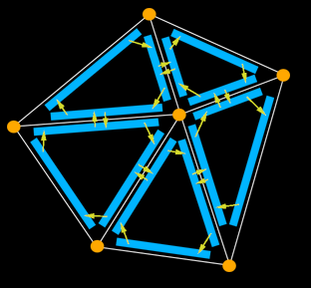
Self-referential structure
More act like self-referential structure
List, graph and half-edge etc.
struct HE_Edge
{
HE_vert * vert;
HE_edge *pair;
HE_face *face;
HE_edge *next;
}

Slide 43
Homework
Write a program to print students’ information (ID number, name, gender, and scores) by the order of their scores.
Write a linked-list version of insertion sorting
Write the k-means algorithms and test on 2-dimensional data generated by K Gaussian distributions. Submit in one week after winter break.

